Slide 1
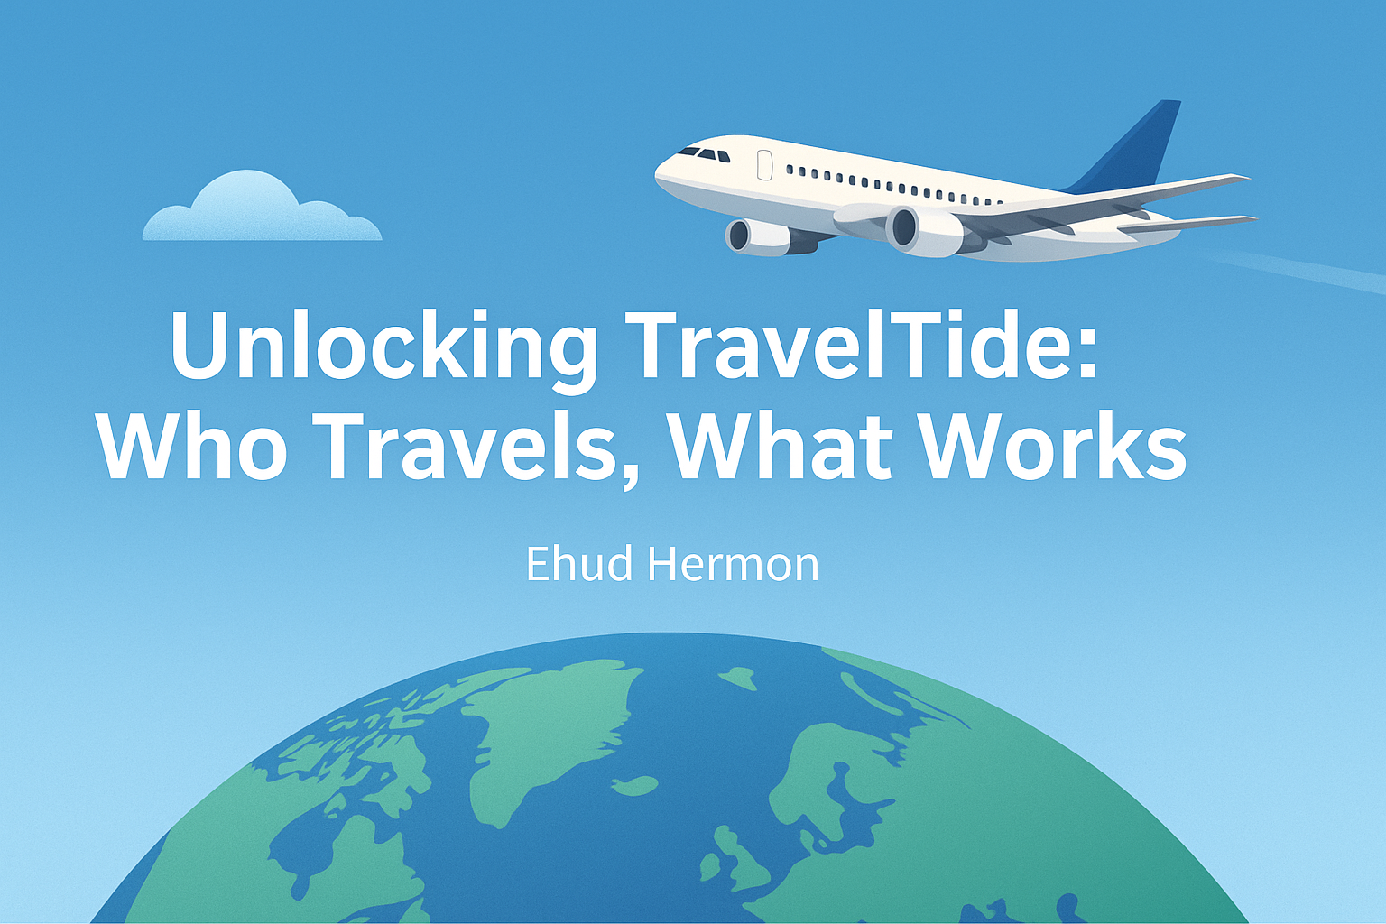

Slide 2

So… Who Really Travels, and What Actually Works?
To match each traveler with the perk they’re most likely to appreciate, we first needed to understand their habits and preferences
By exploring these differences, we identified clear groups of travelers. This helps TravelTide offer more relevant, engaging perks that truly speak to what each group values most.

Slide 3

Data Foundation
Elena highlighted the importance of keeping our analysis grounded in the customer journey.
To stay focused:
We selected active users (8+ sessions)
Used data from Jan 4, 2023 onward
Focused on who they are, how they book, and what they valueֿ
Key data points included:
Demographics (age, marital status, children)
Spending habits (discount use, cost per km)
Engagement (session frequency, trip patterns)
This lens helped us uncover what truly sets different travelers apart.

Slide 4

Segmenting Our Travelers
To better understand our users, we grouped them by behavior and demographics - creating clear segments based on who they are, how they travel, and how much value they bring.
This helps us:
• Spot patterns
→ Understand how different types of travelers ֿbehave.
• Prioritize perks
→ Get the right rewards to theֿ right customer segments.
• Make smarter decisions
→ Focus marketing and product effort where they’ll
have the biggest impact.

Slide 5
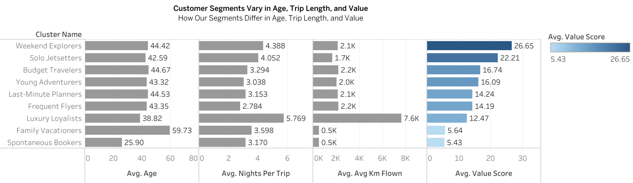
Customer Segments Vary in Age, Trip Style, and Value Each group travels differently — and brings different levels of value

Slide 6

Insights: Not all trips—or travelers—are created equal!
Weekend Explorers deliver the highest value despite flying shorter distances.
Luxury Loyalists take longer trips and spend more per booking.
Spontaneous Bookers tend to be younger,
and bring lower value overall.

Slide 7
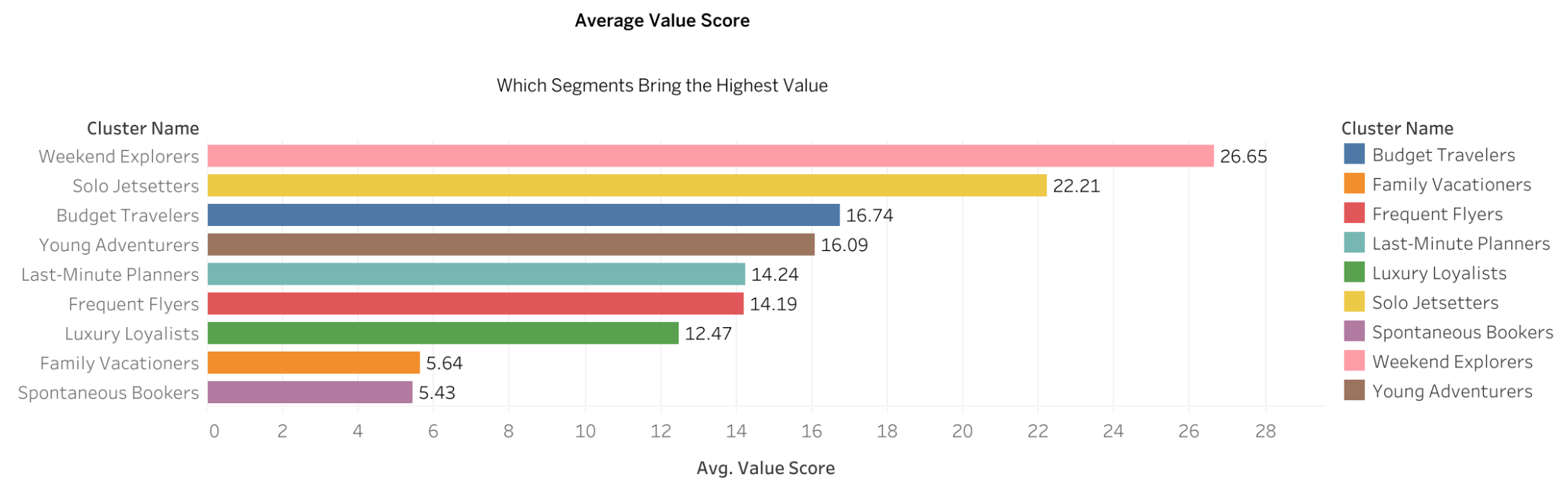
Weekend Explorers and Family Vacationers Deliver the Highest Value

Slide 8

Insights: Value Showdown: From Budget to Premium
Weekend Explorers deliver the highest value, despite flying shorter distances.
👉 This makes them ideal candidates for premium perks or loyalty programs.
Family Vacationers also rank highly, showing strong trip engagement.
👉 Offering bundled deals or family-focused experiences could boost retention.
Solo JetSetters and Budget Travelers perform above average.
👉 Targeted promotions here may yield solid ROI without heavy discounts.
Spontaneous Bookers show the lowest value – consider low-cost perks for this segment.
👉 Low-cost perks or time-sensitive offers might be more effective for this group.

Slide 9
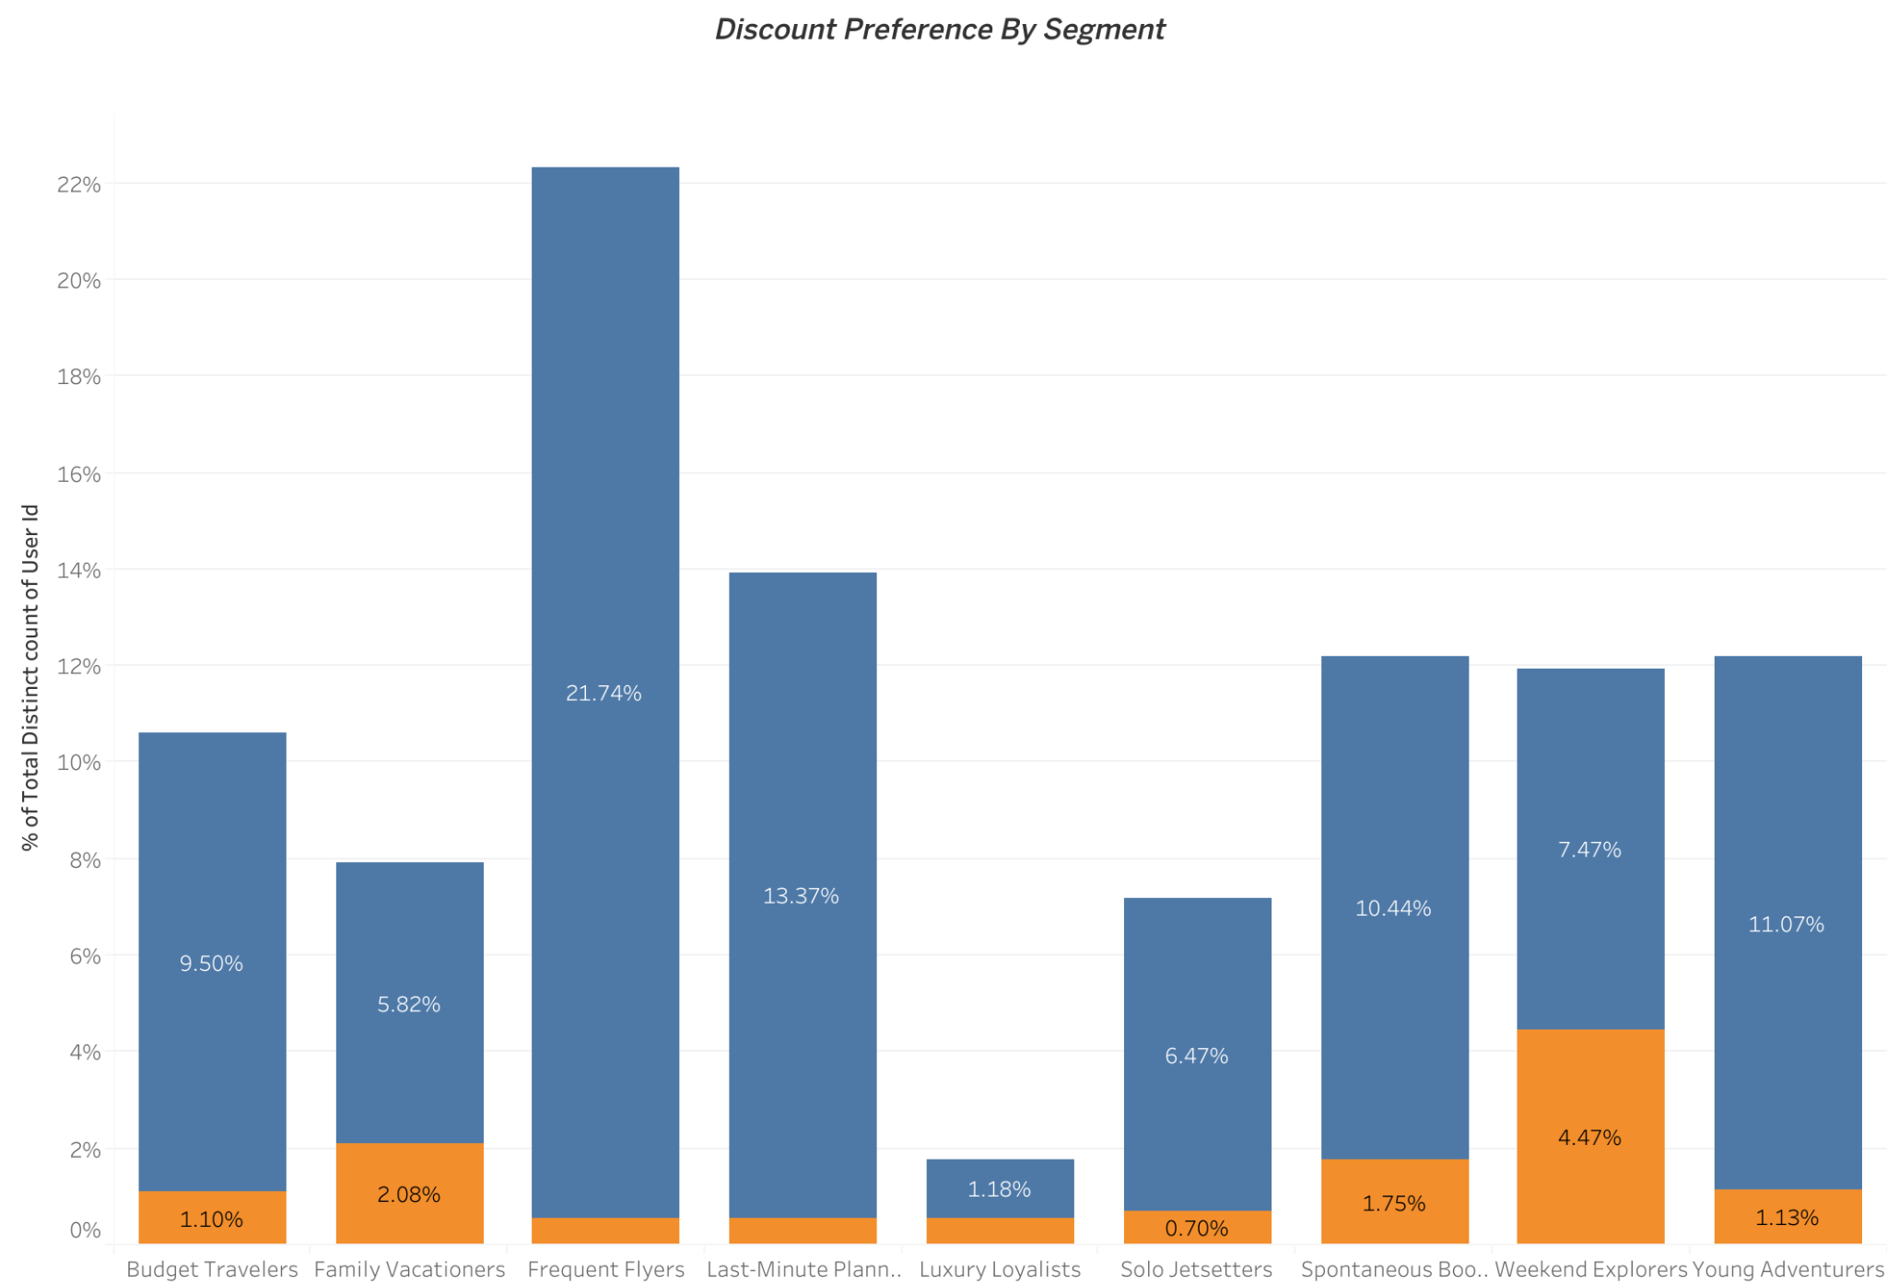
Who Really Cares About Discounts and Who Doesn’t!

Slide 10

Insights: What the Data Says About Discount Sensitivity
Spontaneous Bookers and Budget Travelers are the most price-sensitive. 👉 Targeted discounts could influence booking behavior.
Luxury Loyalists and Solo JetSetters show little interest in deals. 👉 Perks like exclusive access or upgrades may resonate more.
Discount preferences vary sharply across segments. 👉 One-size-fits-all promos likely underperform.

Slide 11
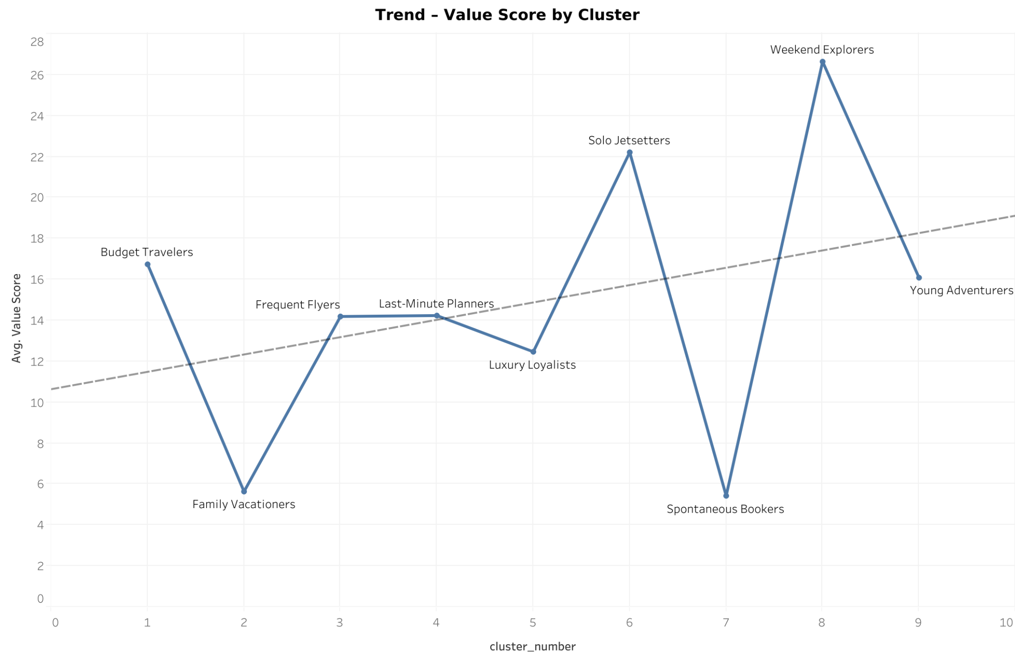
The Higher the Index, the Greater the Value

Slide 12

Insights: What the Trend Tells Us About Value Segments!
Higher-index clusters (like Weekend Explorers and Solo JetSetters) deliver the highest value. 👉 Looks like adventure and flexibility pay off big time.
Mid-index clusters, such as Frequent Flyers and Last-Minute Planners, perform around average. 👉 These folks are steady – not flashy, but not risky either.
Lower-index clusters (notably Family Vacationers and Spontaneous Bookers) bring in lower value. 👉 Charming, but not great for your ROI.
The trend line shows a clear upward pattern — as the index rises, so does customer value. 👉 In short: focus your perks on the top half of this curve.

Slide 13
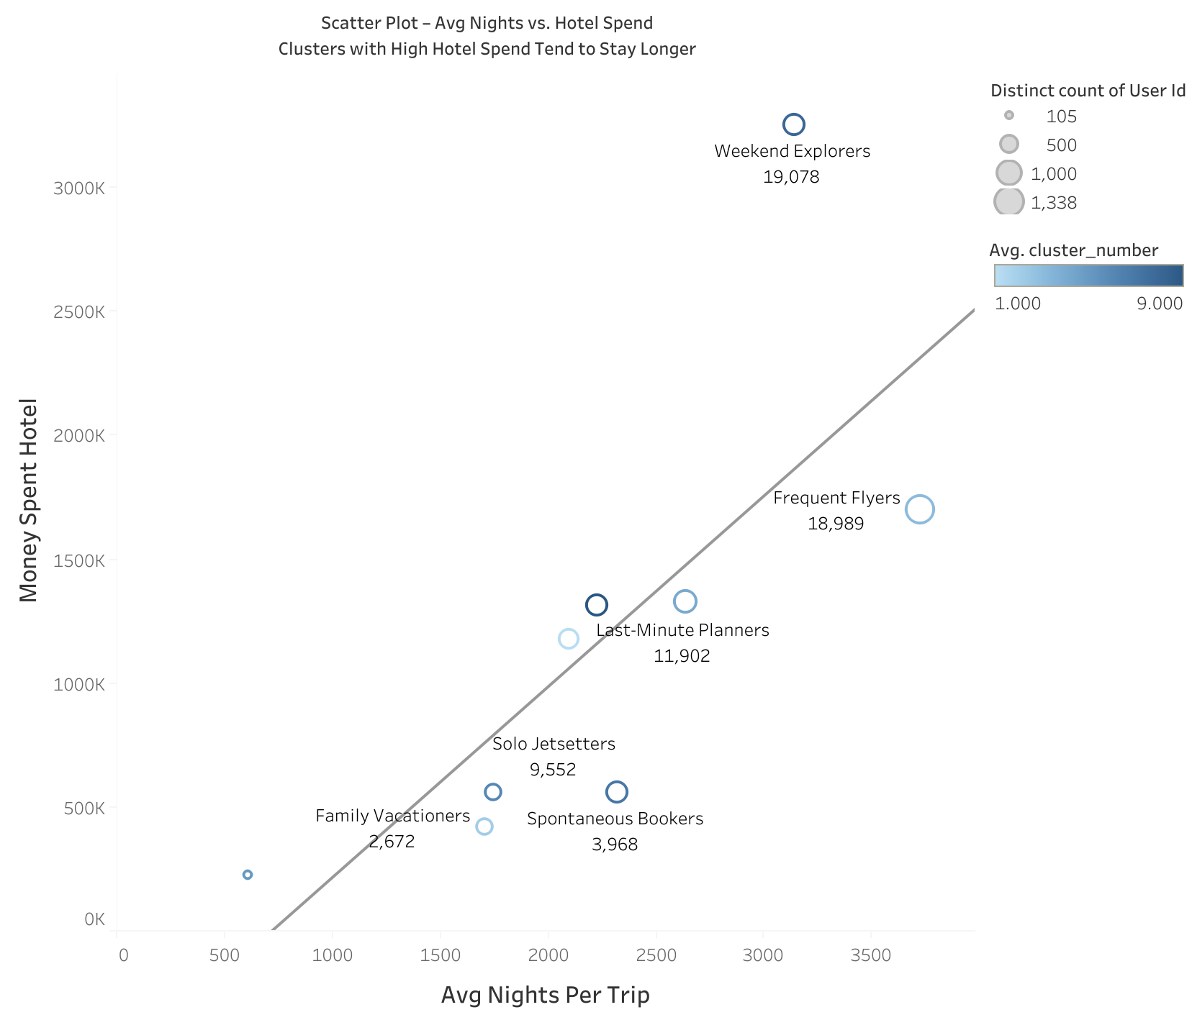
The Longer the Stay, The Bigger the Bill!

Slide 14
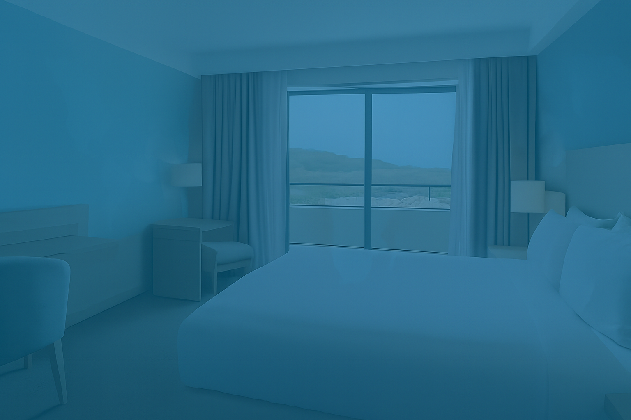
Insights: What the Hotel Spend vs. Trip Length Scatter Reveals!
Weekend Explorers spend significantly more on hotels than other clusters despite average trip duration, standing out as top outliers. 👉 Premium perks or upsell offers may resonate with this high-value segment.
Frequent Flyers also show above-trend hotel spend, possibly due to higher standards or loyalty habits. 👉 Consider loyalty-based perks or business-travel tie-ins.
Family Vacationers and Spontaneous Bookers tend to stay longer for less spend, falling below the trendline. 👉 Cost-conscious packages or bundled discounts may appeal to these groups.
Solo JetSetters and Last-Minute Planners hover around the trendline, showing balanced behavior. 👉 Standard promos or flexible upgrades could tip the decision for these users.

Slide 15
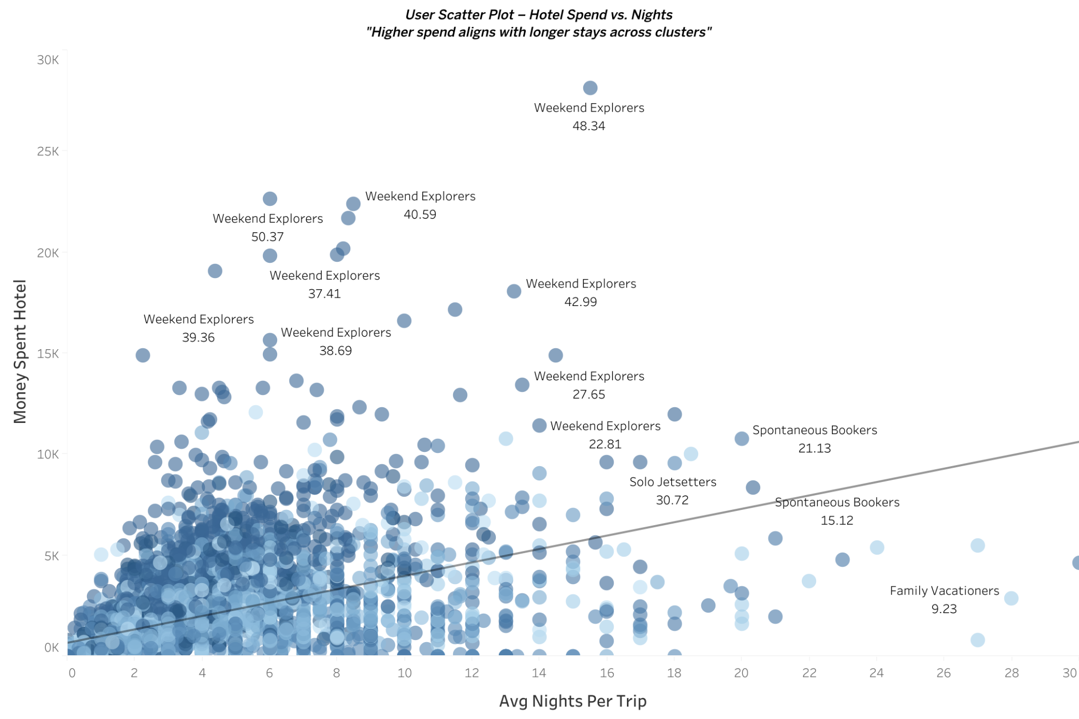
Big Spenders, Short Stays – Who’s Breaking the Pattern?

Slide 16
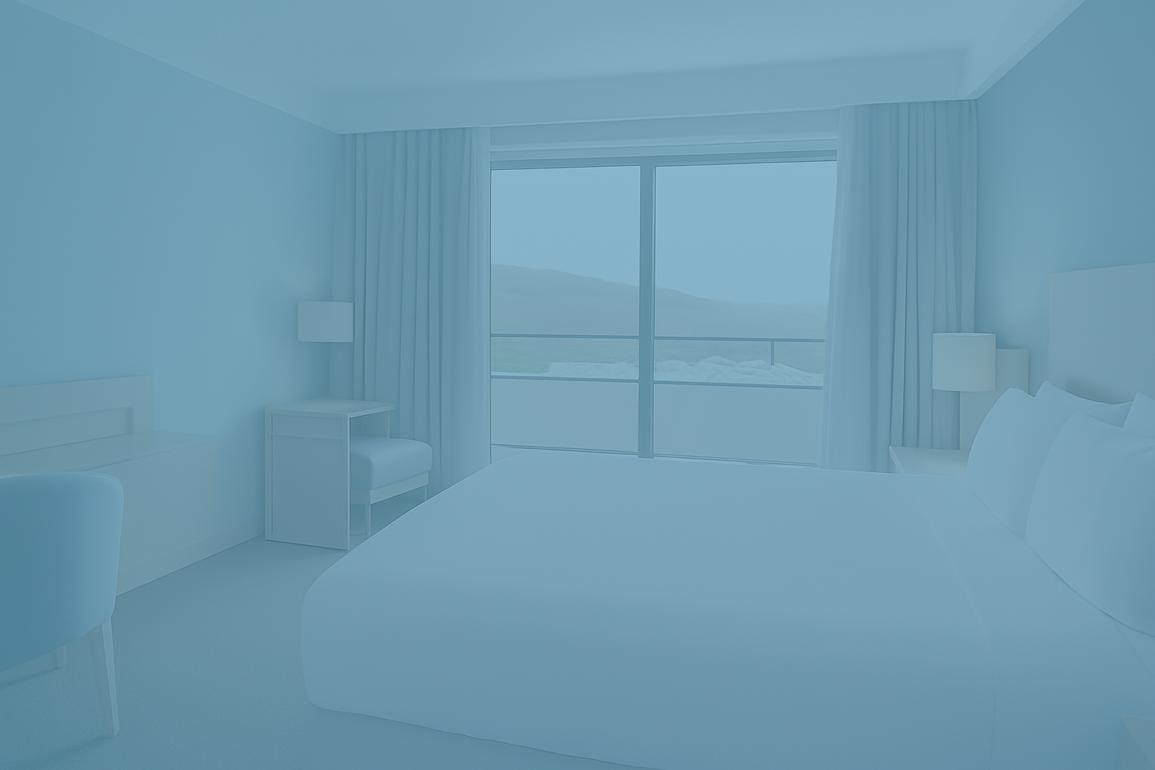
Insights: What the User-Level Data Reveals About Hotel Spend!
Weekend Explorers dominate the top spenders list, even on shorter trips – a clear outlier group breaking the trend. 👉 Premium offers, loyalty tiers, or VIP treatment could hit the mark here.
Spontaneous Bookers and Solo JetSetters show mixed behavior, some splurge while others save, despite similar stay lengths. 👉 Segmented offers may outperform generic campaigns for these groups.
Family Vacationers consistently spend less, even with longer stays – hugging the bottom of the trend. 👉 Bundled family deals or cost-efficient upgrades may better fit their profile.
High-value users aren't always staying longer – especially among top Weekend Explorers. 👉 Duration isn’t everything – consider segmenting by spend behavior too.

Slide 17
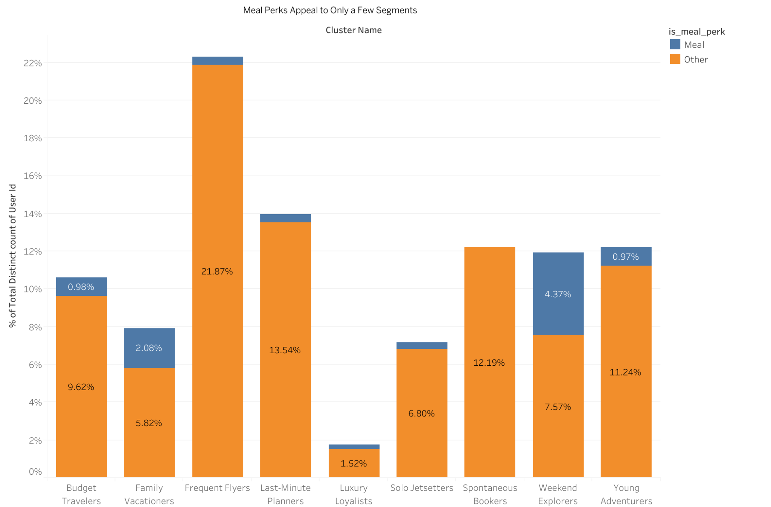
Let Them Eat… Perks? Not Everyone’s Hungry

Slide 18
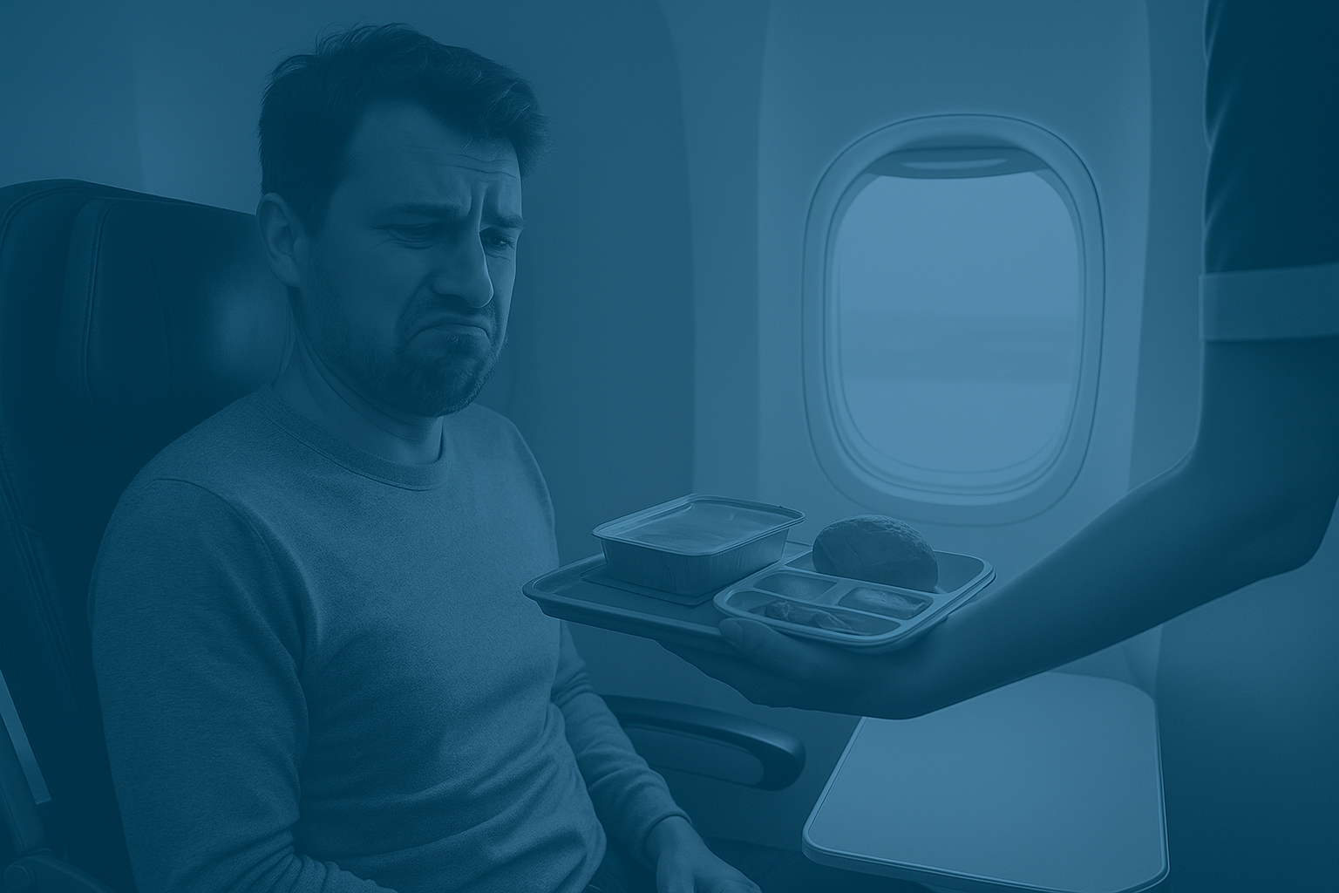
Insights: Some Meals Just Don’t Fly
🍽 Weekend Explorers and Family Vacationers are the only segments with notable meal perk usage. 👉 Meal offers may resonate best with experience-focused or family-driven travelers.
❌ Most other segments, including Frequent Flyers, Luxury Loyalists, and Solo JetSetters, show minimal interest.
👉 Upscale or efficiency-minded travelers likely prioritize flexibility or prefer dining outside.
🍕 Spontaneous Bookers and Young Adventurers also don’t bite— 👉 Consider low-effort or universally appealing alternatives (e.g. snack credit or late checkout).

Slide 19
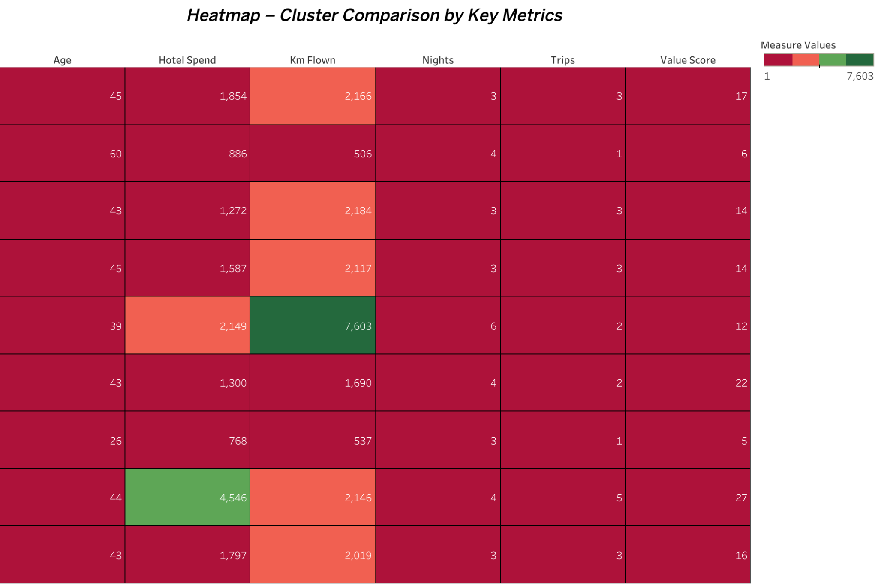
Hot Spots of Value: Where Each Segment Stands Out

Slide 20

🔥 Insights: Which Segments Are Heating Up the Metrics?
Luxury Loyalists and Weekend Explorers dominate key metrics 👉 High hotel spend, distance traveled, and strong value scores make them strategic targets.
Family Vacationers and Frequent Flyers show more modest numbers 👉 Average performance across KPIs suggests stable but unspectacular engagement.
Young Adventurers stand out as the MVPs across the board 👉 Highest value score, strong trip frequency, and consistent hotel spend position them as top-tier customers.
Budget Travelers and Spontaneous Bookers lag behind 👉 Low spend and travel metrics make them less lucrative but possibly responsive to promotions.

Slide 21
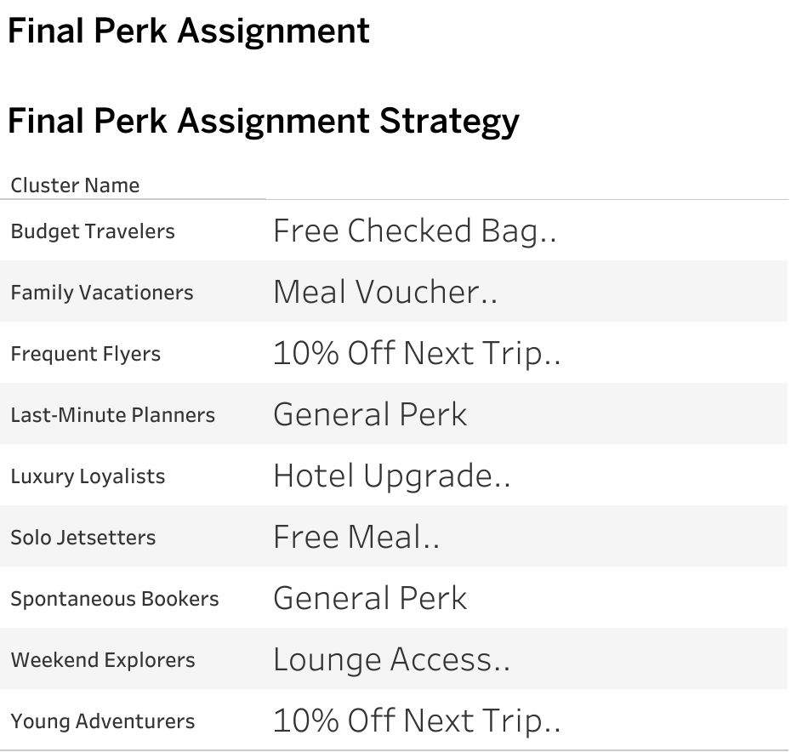
💎 Perks with Benefits: Tailoring Purposes to Each Traveler Segment

Slide 22

🔍 Final Takeaways: What the Data Told Us About Traveler Perks
✈️ Different segments, different priorities: No single perk fits all. Tailored offers boost engagement.
🍽️ Meals & upgrades only work for select clusters: Focus them on receptive groups like Family Vacationers and Luxury Loyalists.
💰 Discounts matter to price-sensitive users: Target Spontaneous Bookers and Budget Travelers with monetary offers.
💼 Lounge access, hotel upgrades, and checked bags speak to loyalty: These resonate with higher-value and frequent flyers.
🔁 General perks suit undecided or low-engagement users.

Slide 23
🎯 Strategy Summary: Why We Matched Each Perk
Budget Travelers – Free Checked Bag: Keeps costs low for high-sensitivity group.
Family Vacationers – Meal Voucher: Supports families and boosts satisfaction.
Frequent Flyers & Young Adventurers – 10% Off Next Trip: Encourages repeat booking from active travelers.
Luxury Loyalists – Hotel Upgrade: Appeals to premium expectations.
Solo JetSetters – Free Meal: Enhances travel comfort for frequent independents.
Weekend Explorers – Lounge Access: Matches their frequent short but high-value travel.
Spontaneous Bookers & Last-Minute Planners – General Perk: Flexible for unpredictable behaviors.
“Every perk has a purpose — chosen based on data, not guesswork.”

Slide 24

🌍 Thank You for Traveling This Journey With Us!
We’re excited to turn insights
into impact - one traveler at a time!!!

